Slide 1
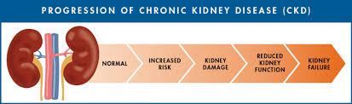
Project Presentation
Edmond Tetsuekoue
Regis University
MSDS692 - Data Science Practicum I
March 5, 2023

Slide 2
Content
1. Problem or Situation
2. Research Question
3. The Data (Dataset)
4. Methodology
5. Results
6. Model Evaluation
7. Conclusions

Slide 3
Problem or Situation
In this project, my goal is to look at the factors that could be indicative of kidney failure and predict the likelihood of someone suffering from the disease. I approach the problem from two angles. I first looked at “Factors to be taken seriously at home” and then explored “Factors from a physician perspective”. I used a copy of the "kidney_disease" dataset from the data repository of the University of California Irvine (UCI).

Slide 4
Research Question
- What are the factors increasing the likelihood of an individual
to suffer from ckd (chronic kidney disease)?
- Predict the odds of a random individual to suffer from ckd.

Slide 5
The Data
PassengerId
For this project, I will be using a copy of the “kidney_disease” dataset from the University of California Irvine (UCI) that can be found at:
https://archive.ics.uci.edu/ml/datasets/chronic_kidney_disease
It is a multivariate dataset made of real data. It has 400 Instances and 25 attributes. To increase the accuracy of the model that will be used for the prediction, these missing values will need special treatment. It is worth mentioning that all the attributes of the dataset are not “equal” regarding the question that is being investigated in this project. The one with no direct relevancy to the model will be eliminated to improve the performance of the algorithm.

Slide 6
The Data
1) age: Age(numerical) - age in years
2) bp: Blood Pressure(numerical) bp in mm/Hg
3) sg: Specific Gravity(nominal) sg - (1.005,1.010,1.015,1.020,1.025) concentration of particles in urine (density of urine compared with the density of water)
4) al: Albumin(nominal)al - (0,1,2,3,4,5)
5) su: Sugar(nominal) su - (0,1,2,3,4,5)
6) rbc: Red Blood Cells(nominal) rbc - (normal, abnormal)
7) pc: Pus Cell (nominal)pc - (normal, abnormal) pus cells (White blood cells) in urine (Pyuria) are signs of infection, it is significant if there are more than 4 pus cells/HPF in a centrifuged urine sample.
8) pcc: Cell clumps(nominal)pcc - (present, notpresent) Large clumps of WBCs are typically observed when there is inflammation or bacterial infections of the renal and urinary tract.
9) ba: Bacteria(nominal) ba - (present, notpresent)
10) bgr: Blood Glucose Random(numerical) bgr in mgs/dl
11) bu: Blood Urea(numerical) bu in mgs/dl
12) sc: Serum Creatinine(numerical) sc in mgs/dl

Slide 7
The Data
13) sod: Sodium(numerical) sod in mEq/L
14) pot: Potassium(numerical) pot in mEq/L
15) hemo: Haemoglobin(numerical) hemo in gms
16) pcv: Packed Cell Volume(numerical) Hematocrit (HCT) and packed cell volume (PCV) are used to measure red blood cell mass. An increase in red blood cell mass is equivalent to erythrocytosis and a decrease indicates an anemia.
17) wc: White Blood Cell Count(numerical) wc in cells/cumm
18) rc: Red Blood Cell Count(numerical) rc in millions/cmm
19) htn: Hypertension(nominal) htn - (yes, no)
20) dm: Diabetes Mellitus(nominal) dm - (yes, no)
21) cad: Coronary Artery Disease(nominal) cad - (yes, no)
22) appet: Appetite(nominal) ppet - (good, poor)
23) pe: Pedal Edema(nominal) pe - (yes,no)
24) ane: Anemia(nominal)ane - (yes,no)
25) classification: Class (nominal) class - (ckd, notckd)

Slide 8
Methodology
The approach used to solve this problem will consist of different steps:
Clean and prepare the data.
The cleaning and the preparation of the data were completed by:
Identifying NaNs with the use of the isnull() function.
Replacing categorical NaNs with the mode.
Replacing numerical NaNs with the MICE (Multivariate Imputation by Chained Equations).

Slide 9
Methodology
2) Exploratory data analysis and correlation testing.
Pearson's correlation methods led to finding a strong correlation between these variables:
Determining factors from a physician’s perspective:
Chronic Kidney Disease and Specific Gravity: corr = -0.7
Chronic Kidney Disease and Albumin: corr = +0.6
Chronic Kidney Disease and Hemoglobin (gms): corr = -0.73
Chronic Kidney Disease and Packed Cell Volume: corr = -0.69
Determining Factors to be taken seriously at home:
(May point towards the disease pending further analysis)
Chronic Kidney Disease and Hypertension: corr = -0.59
Chronic Kidney Disease and Diabetes Mellitus: corr = +0.56
Chronic Kidney Disease and Appetite: corr = -0.39
Chronic Kidney Disease and Pedal Edema: corr = +0.38
Chronic Kidney Disease and Anemia: corr = +0.33

Slide 10
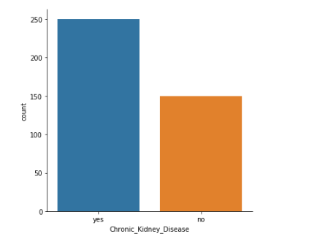
Methodology
Determining Factors to be taken seriously at home:
Distribution of the target variable

Slide 11
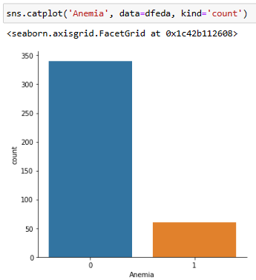
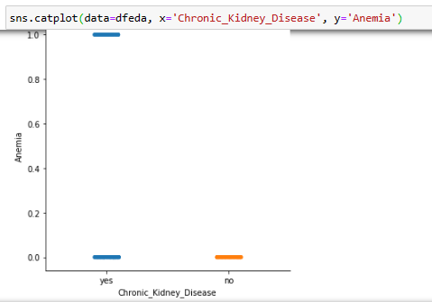
Methodology
Chronic Kidney Disease vs Anemia: corr = +0.33
Distribution CKD vs Anemia

Slide 12
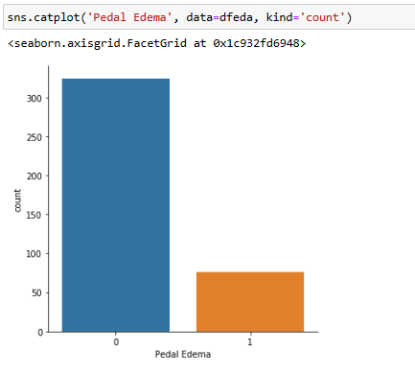
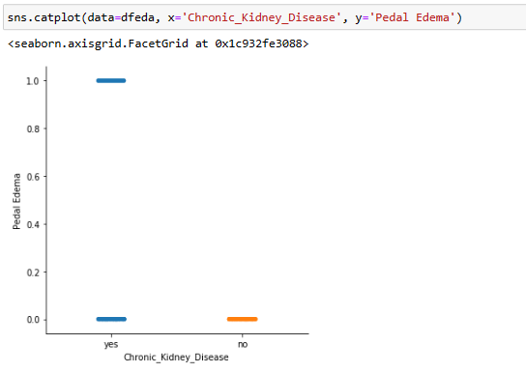
Methodology
Chronic Kidney Disease vs Pedal Edema: corr = +0.38
Distribution CKD vs Pedal Edema

Slide 13
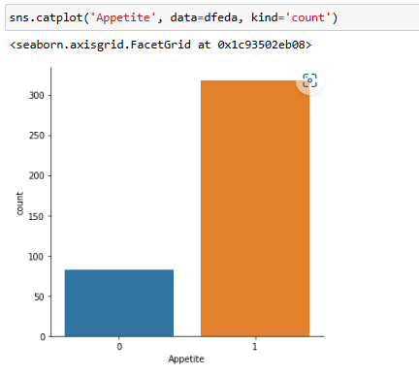
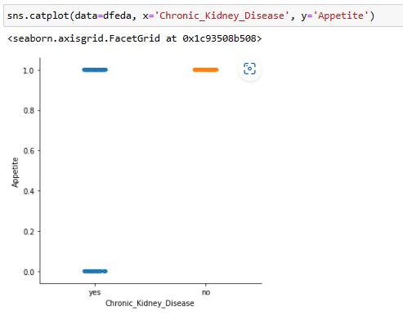
Methodology
Chronic Kidney Disease and Appetite: corr = -0.39
Distribution CKD vs Appetite

Slide 14
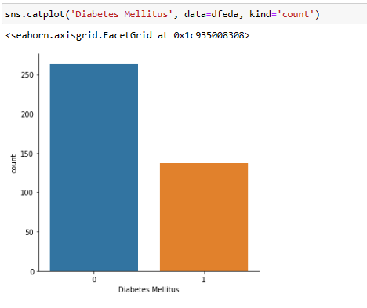
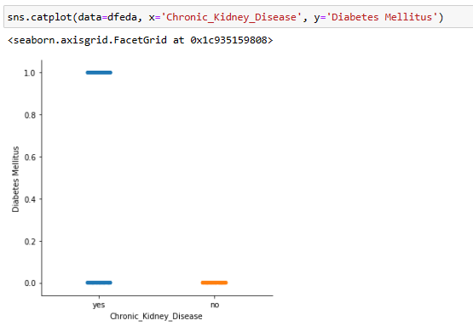
Methodology
Chronic Kidney Disease and Diabetes Mellitus: corr = +0.56
Distribution CKD vs Diabetes Mellitus

Slide 15
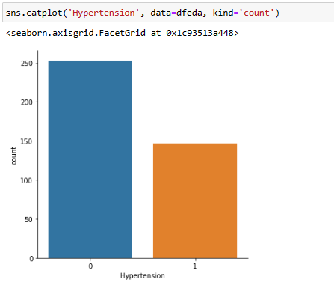
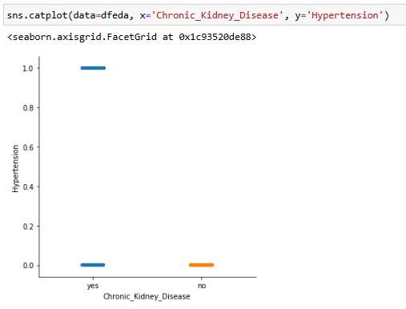
Methodology
Chronic Kidney Disease and Hypertension: corr = -0.59
Distribution CKD vs Hypertension

Slide 16
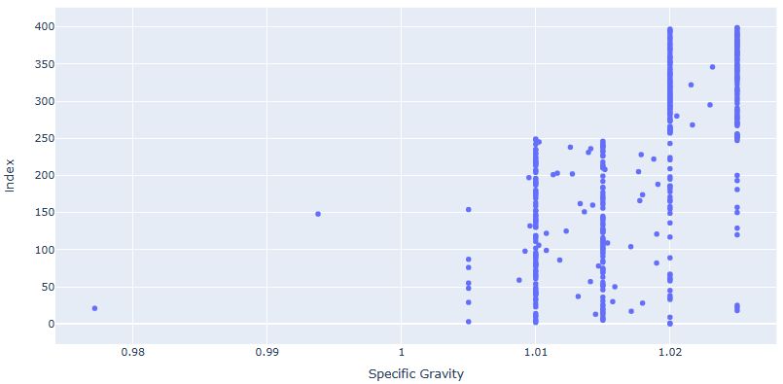
Methodology
Determining factors from a physician’s perspective:
Specific Gravity distribution

Slide 17
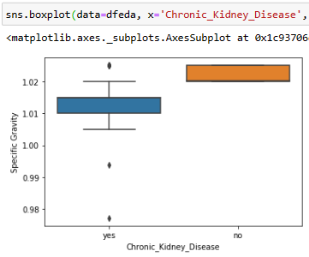
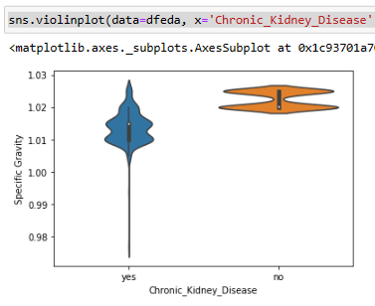
Methodology
Specific Gravity & ckd

Slide 18
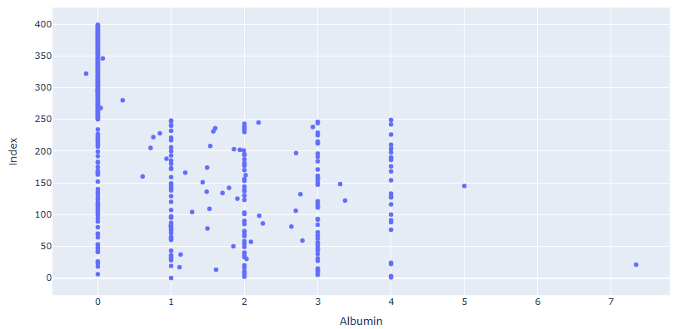
Methodology
Chronic Kidney Disease and Albumin: corr = +0.6
Albumin distribution

Slide 19
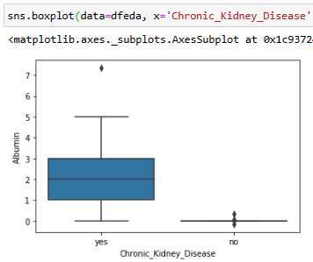
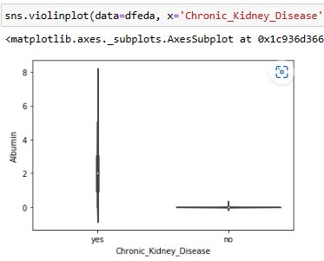
Methodology
Albumin & CKD

Slide 20
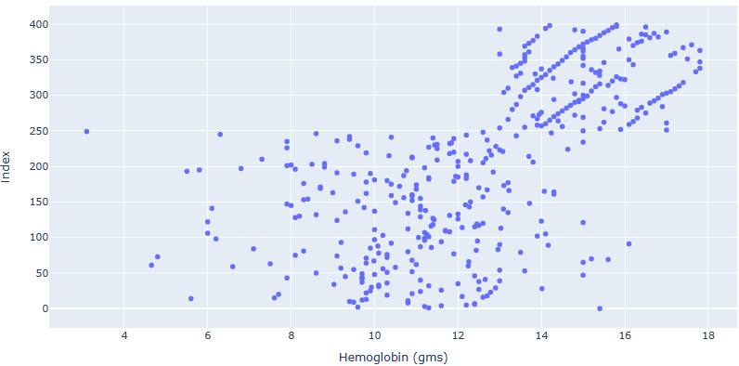
Methodology
Chronic Kidney Disease and Hemoglobin (gms): corr = -0.73
Hemoglobin (gms) distribution

Slide 21
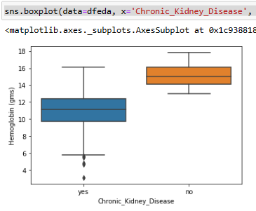
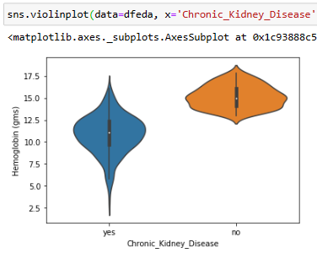
Methodology
Hemoglobin (gms) & CKD

Slide 22
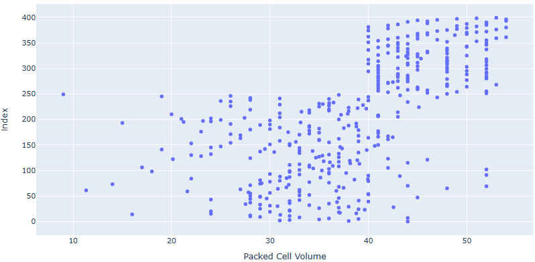
Methodology
Chronic Kidney Disease and Packed Cell Volume: corr = -0.69
Packed Cell Volume distribution

Slide 23
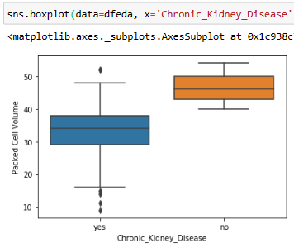
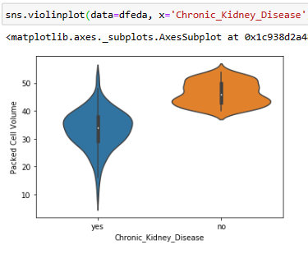
Methodology
Packed Cell Volume & CKD

Slide 24
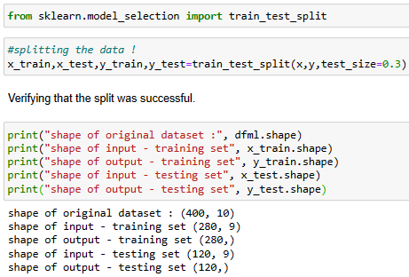
Methodology
3) Splitting the data into a training and a testing set.
The “train_test_split” from the Sklearn library was used to split the data at a ratio of
(70:30) respectively for the training and testing set.

Slide 25

Methodology
Machine Learning algorithms applied to training and testing sets.
4.1 Importing the model.
The best method to solve these types of classification problems appears to be the logistic regression model.
4.2 Creating an instance of the Model.
4.3 Training the model on the data.

Slide 26

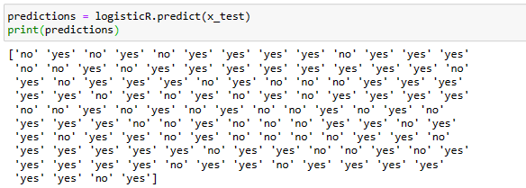
Results
5.1 Testing the model.
The model uses the information it learned during the model training process in “4.3” to predict the outcome of the first 10 patients of the testing set.
0: The individual suffers from CKD
1: The individual does not suffer from CKD
5.2 Applying the model on the whole test data set

Slide 27

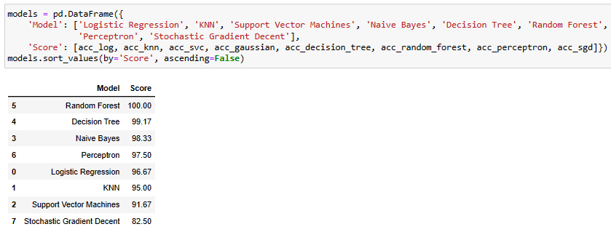
Model Evaluation
6) Model accuracy evaluation.
6.1. Using the “score” method to evaluate the accuracy of the model.
The accuracy test is used as a calculation to determine how accurate the model is.
The accuracy was 96.67. This is a good result in my opinion.
6.2. Running the data through additional models and ranking all the models.
Comparing the model with other models to see how it fares.

Slide 28
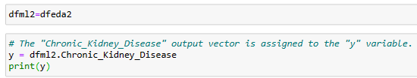
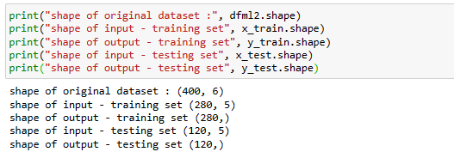
Model Evaluation
6) Model accuracy evaluation.
6.3. Model evaluation on Factors to be taken seriously at home.
6.3.1 Creating a subset of the dataset
6.3.2 Re-splitting the data

Slide 29

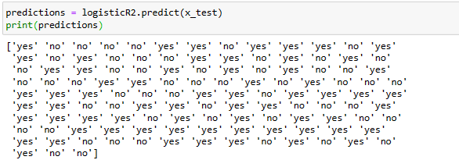
Model Evaluation
6) Model accuracy evaluation.
6.3. Model evaluation on Factors to be taken seriously at home.
6.3.1 Creating an instance of the model.
6.3.2 Training the model.
6.3.3 Testing the model on the first 10 elements.
6.3.4 Testing the model on the whole test instance.

Slide 30
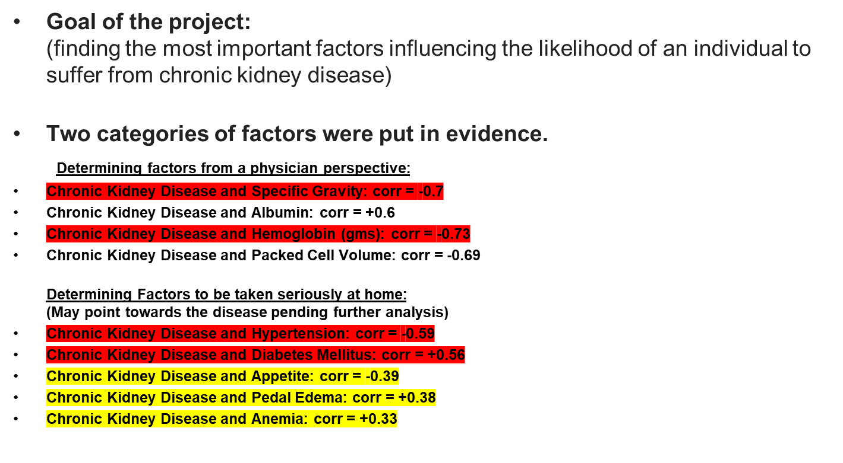
Conclusion

Slide 31
Conclusion
"LogisticRegression()" used for the predicting phase of the project (Accuracy score of 96.67) Model executed on the whole dataset.
Random Forest and Decision Tree ended up scoring better than regression.
Model executed on “Factors to be taken seriously at home”
(The exact same predictive result was obtained confirming the validity of approaching the problem from both perspectives “home factors” & “hospital factors”)
Factors that impacted the accuracy of the model and possibilities of improvement. (restricted sample data used / missing values)
Final thought on the project
(very comprehensive data science project).

